Slide 1


Customer Testimonial

Slide 2
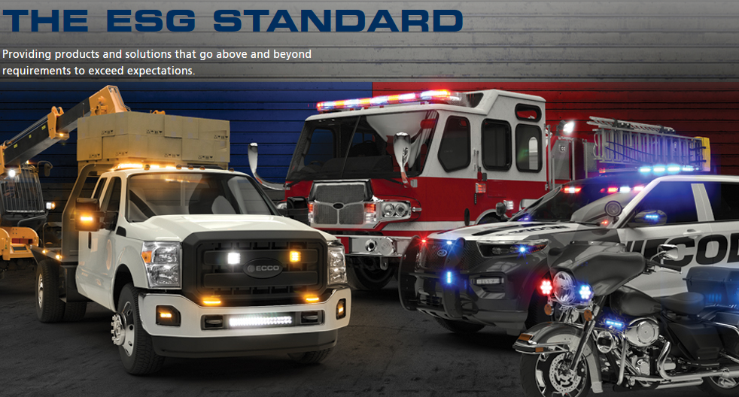

Slide 3
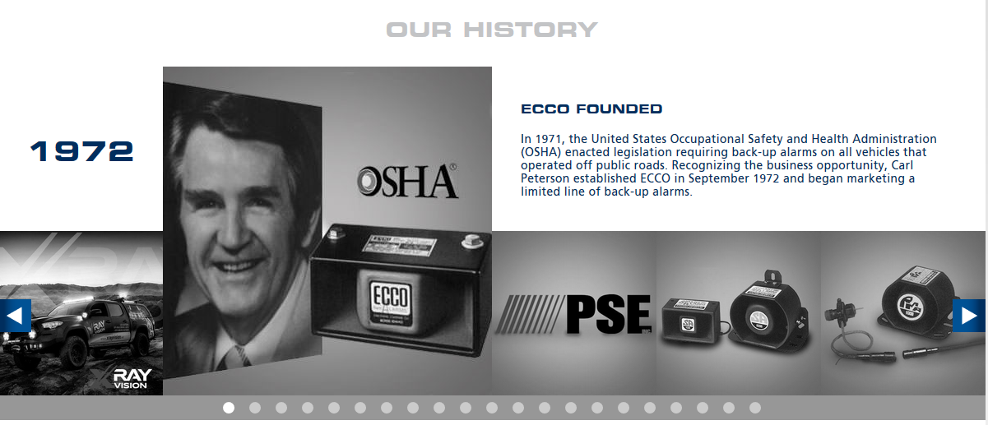

Slide 4


Locations around the world
Boise, Idaho
St. Louis, Missouri
Leeds, England
Ulm, Germany
Lyon, France
Melbourne, Australia
Suzhou, China

Slide 5
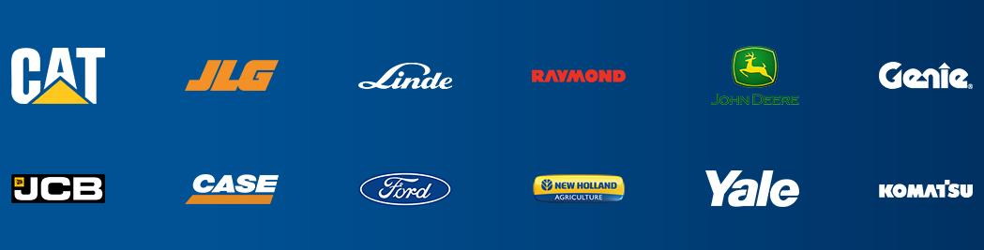

Slide 6

Q. Why ESG chose Veeam?
A. Easy to implement. Feature rich. Has an API!
Q. What we don’t like about it!
A. Veeam does not work fast enough to stay up with VMware updates – this causes us to fall behind current features and sometimes patches.

Slide 7

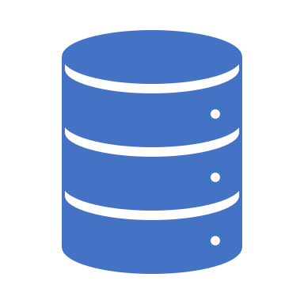
ESG's automated backup solution
Veeam Backup and Recovery
The most important thing we do as System Administrators is backups.
Why automate backups?
Too many times, we run into issues where we were too busy during the building of a new server or process and forgot a step (backups, monitoring, fine tuning, etc).
Without backups, in the event of a DR situation, we cannot recover that specific server, file or application.

Slide 8
System Installation Requirements:
1. The Backup Server (Windows 2012r2 or Windows 2016).
2. This server needs to have Veeam Backup and Recovery 9.+ and VMWare PowerCLI installed.
3. The credential files need to be created\copied to c:\batch\zabbix\VeeamBackups
4. ESG-VeeamBackups PowerShell Module must be ‘installed’ on the backup server.
5. C:\batch\zabbix\veeam (for monitoring\stats - deployed through Group Policy)
6. C:\batch\zabbix\veeambackups (for backup job creation - deployed through Group Policy)
7. Scheduled task: Veeam Job Create

Slide 9
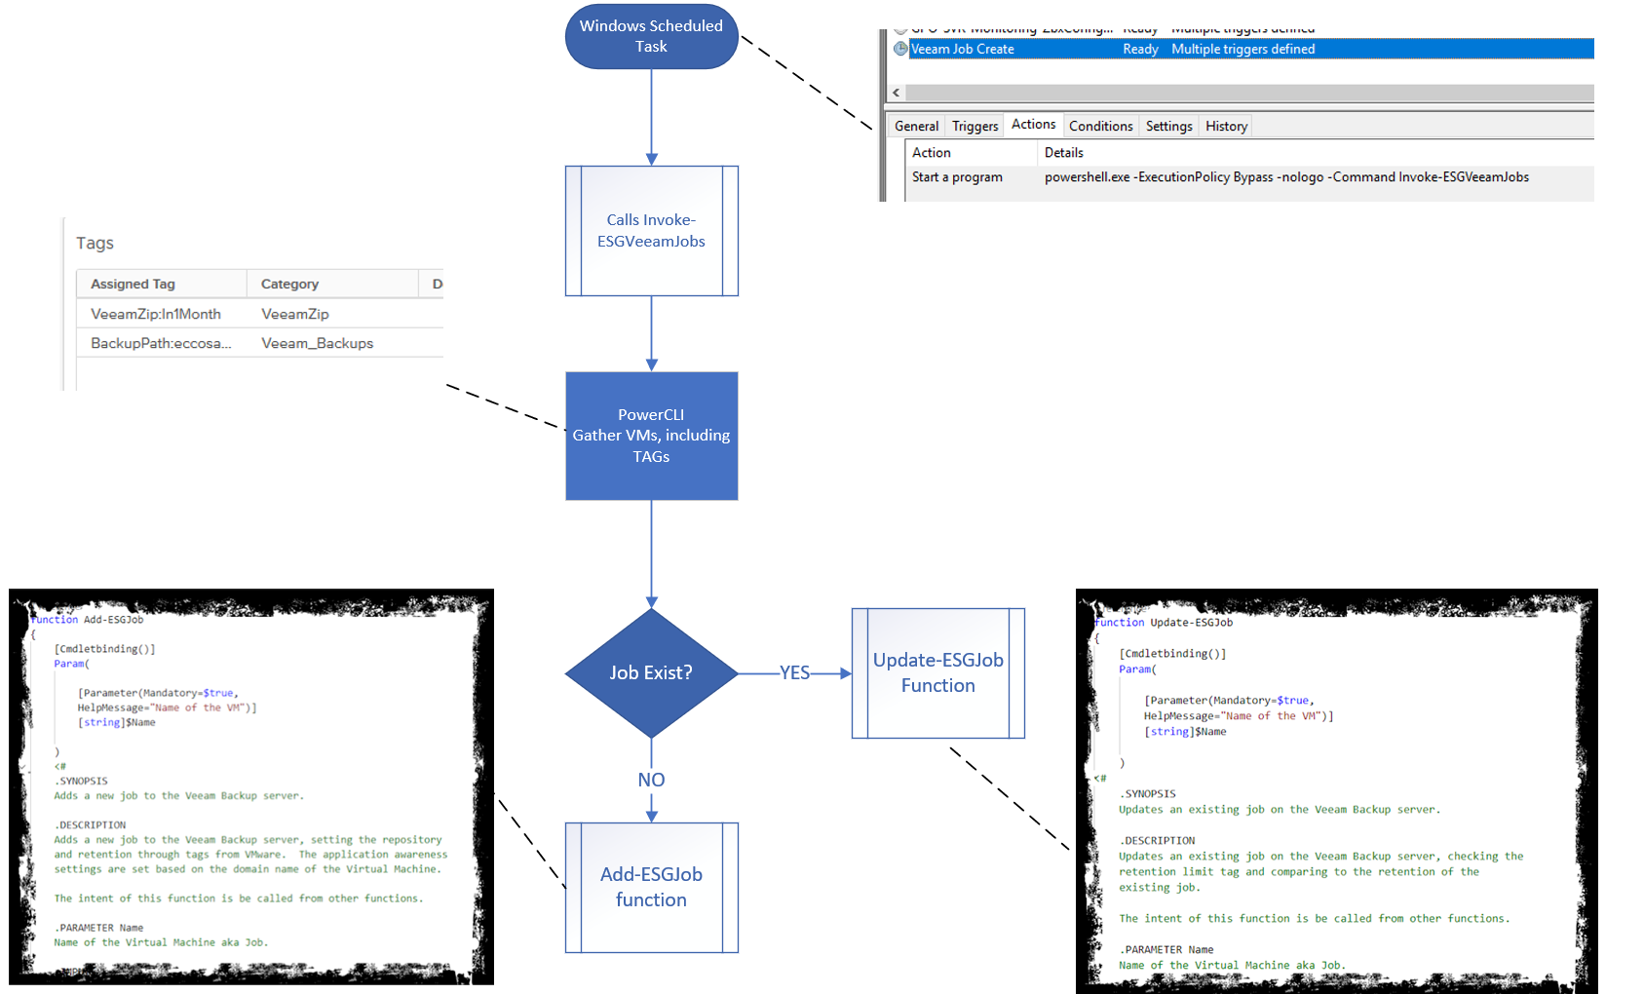

Slide 10

What’s Next?
-Automate recovery and backup validation in a sandbox for compliance.

Slide 11

Questions?

